Slide 1
Updating your Surface
Does your Surface have a 40% or greater charge? Check by clicking on the battery icon. Updates will not complete unless your Surface is charged at least 40%.
If your device is charged enough, follow the directions in this PowerPoint to manually update.
If your Surface is not charged, follow along and get as far as you can—then finish tonight after you charge.
Keeping your Surface charged is extremely important! All kinds of things start going wrong when you get down below 25%!

Slide 2
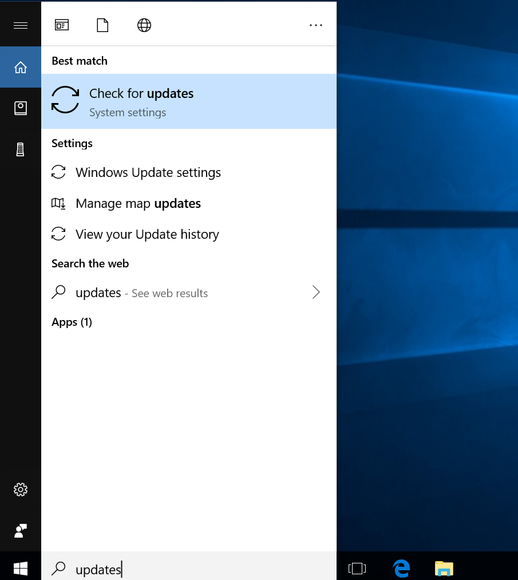
How to manually check for updates on your Surface 3
Type “updates” in the search bar
Click on “Check for updates.”

Slide 3
Your Surface is probably not really up to date!
This Surface looks like it is up to date, but it is NOT!
Always press “Check for updates” unless the date Last Checked is today or yesterday

Slide 4
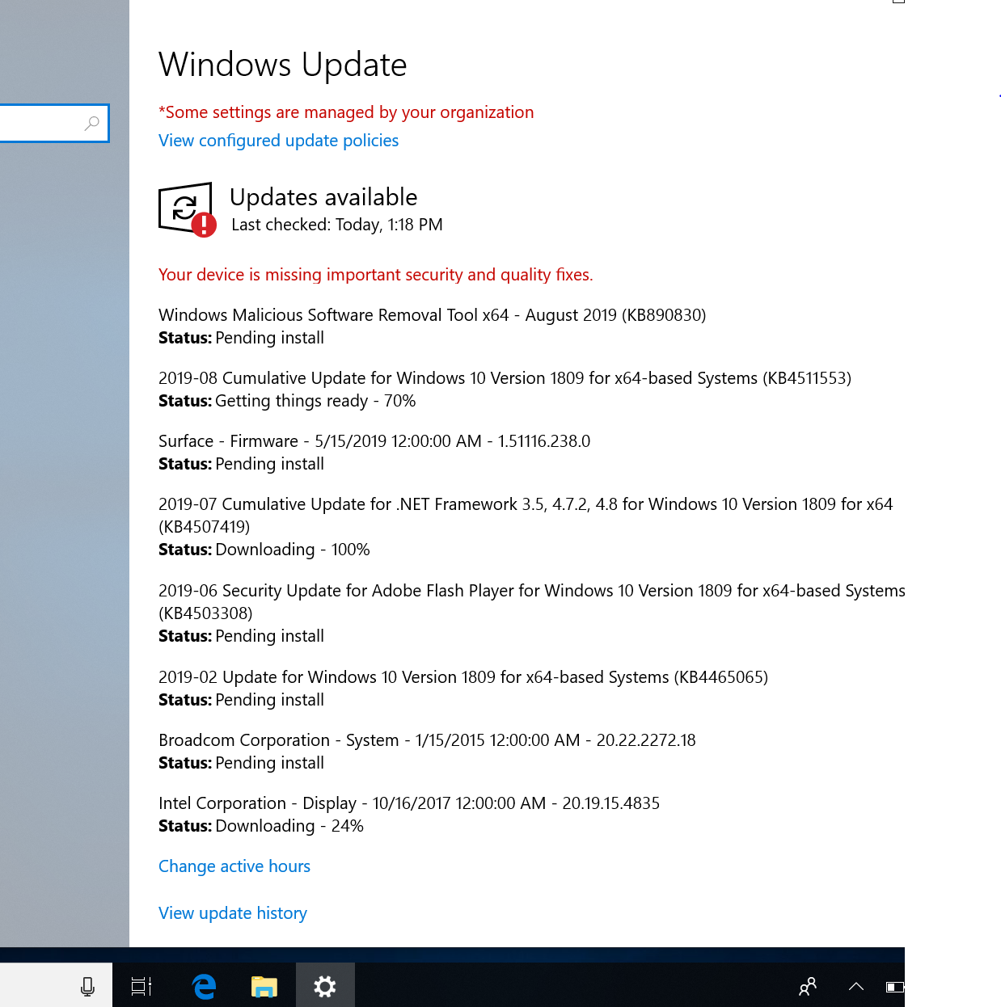
Follow the directions to download and install updates
Check in periodically to make sure process is happening
This will involve one or more restarts

Slide 5
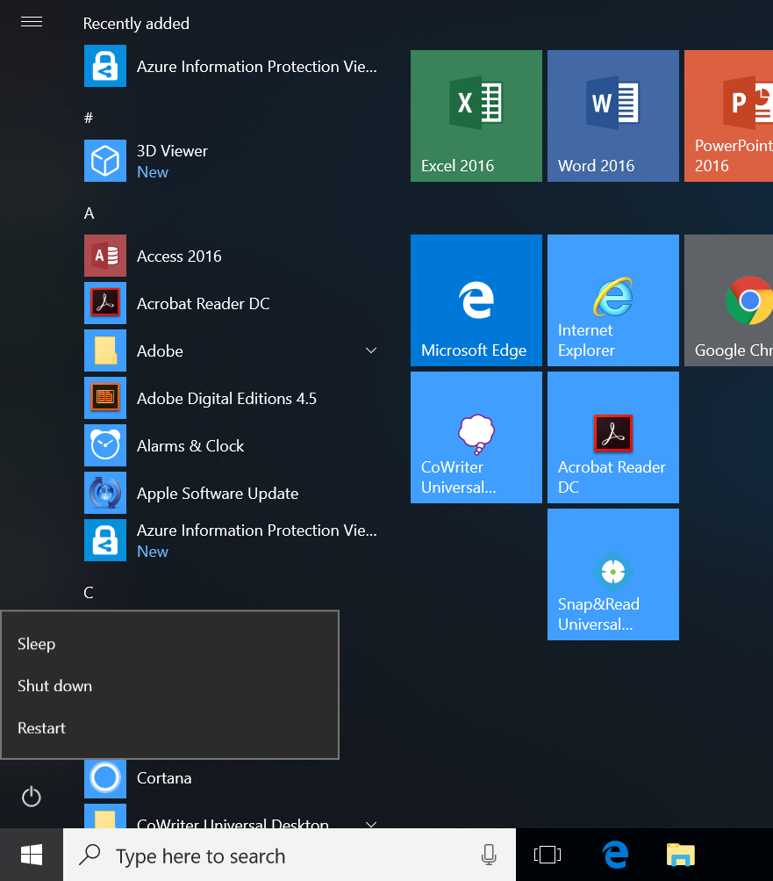
Make sure to restart properly!
Tap the Windows icon then the power icon
Choose “Restart”
This is the way you should restart the Surface every single night. Restarting properly one or more times a day will help ensure that your Updates are downloading and installing automatically.

